Slide 1
Welcome - We will start at 12:30 Sheffield Area Prescribing Group – Learning Lunch 5 December 2024 Sheffield Medicines and Prescribing

Slide 2
Introductions
Emily Parsons - Medicine Safety Officer
Barbara Obasi - Clinical Effectiveness Pharmacist
Helen Taylor – Lead Pharmacist
House Keeping

Slide 3
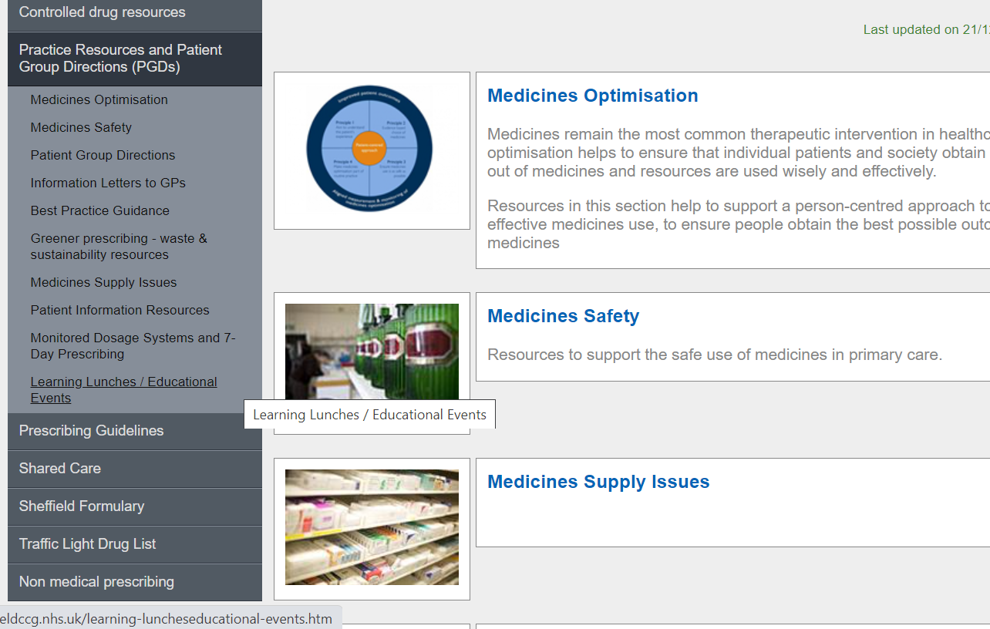
Missed the meeting/other learning lunch resources
https://www.intranet.sheffieldccg.nhs.uk/medicines-prescribing/learning-luncheseducational-events.htm

Slide 4
Learning objectives
To be aware of latest updates & suggested actions:
IMOC Approved Traffic Light Drug List
Opioid Resources
Medicines Safety update
General prescribing update – NICE Guidance (Update)
Education &Training opportunities

Slide 5
Traffic Light Drug List
Drug | Indication | SY ICB Traffic Light Status
Dexcom One + Freestyle Libre 2+ |  | Amber G (1)
Canagliflozin Empagliflozin Dapagliflozin Ertugliflozin | Treating type 2 diabetes | Green
*** Please note: SY ICB GREY TLS is equivalent to BLACK on Sheffield’s TLDL***
To access both SY ICB TLDL and Sheffield place TLDL: Sheffield place intranet > Medicines and Prescribing > TLDL
Optimise Rx will be updated with all IMOC approved TLDL changes.
Avoid adding any RED medicines prescribed by hospital to patient’s repeat record. Add as ‘hospital only drug’

Slide 6
New SY Opioid Prescribing Resource
Opioid_Prescribing_Resource_Including_Tapering_Advice_v1.pdf helentaylor5@nhs.net

Slide 7
Key headlines from Opioids Aware, Faculty of Pain Medicine
Opioids are very good analgesics for acute pain and for pain at the end of life, but there is little evidence that they are helpful for long-term pain.
A small proportion of people may obtain good pain relief with opioids in the long term if the dose can be kept low and especially if their use is intermittent.
Risk of harm increases substantially at doses above an oral morphine equivalent (OME) of 120 mg/day* but there is no increased benefit.
*Additional dosage increases beyond 50 mg/day OME are progressively more likely to yield diminishing returns in benefits for pain and function relative to risks to patients as dosage increases further.
If pain is severe despite opioid treatment, it means opioid isn't working and should be stopped, even if no other treatment is available.
Chronic pain is very complex and if patients have refractory and disabling symptoms, particularly if they are on high opioid doses, an assessment of the emotional influences on their pain experience is essential.

Slide 8
Indications for opioid tapering
Consider at least every 6-12 months irrespective of dose to assess benefit and side-effects.
Opioid no longer beneficial e.g. severe pain despite opioid. Consider using a pain scale e.g. British Pain Society Pain Scale
High dose opioid > 120 mg /day oral morphine equivalent (OME) where evidence shows risk of harm outweighs benefit (note: diminishing benefit and increased risks at doses above 50 mg /day OME – see here)
Condition for which opioid was prescribed has resolved e.g. joint replacement.
Person wants to stop taking the medicine e.g. intolerable adverse effects.
Problems associated with dependence have developed or strong evidence the person is diverting medication to others.
Having a 'conversation' is key!- discuss 'Tapering' at regular intervals (e.g. annual review) so patient can assess if still on-going benefit.
Try to ensure acute opioids don’t become long term. Increased risk of dependence and addiction if opioid taken for > 3 mths. Chronic pain is defined as pain last 3 mths or more.

Slide 9
Consider opioid side-effects
Not a complete list: …
Constipation
Weight gain
Hormonal effects - sexual dysfunction, amenorrhea, infertility
Depression / mood changes - people often don’t realise the negative impact opioids have on their mood and function
Reduced ability to fight infections
Memory loss
Increased risk of fractures (osteoporosis) and falls
Difficulty sleeping (snoring and breathing difficulties)
Opioid-induced hyperalgesia
Problems associated with dependence and addiction
Respiratory depression, increased mortality
Focus on those side-effects relevant to the patient. More likely to engage with the process

Slide 10
Agree and document a plan
Acknowledge and discuss with the person any differences between their views and your own about risks and benefits of taking an opioid.
If asked about previous prescribing decisions, explain our understanding of the balance of risks and benefits of opioid medicines has changed over time.
Aim: taper without withdrawal symptoms, example of Tapering Plans for each of the opioids.
Involve patient in decision about tapering plan – be supportive / empathic
10% reduction every 1-2 weeks (consider every 4 weeks if opioid taken > 1 year or 'higher dose')
Fentanyl TD – if pt not coping with reduction consider small quantity of IR opioid (max 7 days after patch reduction).
Tolerance is soon lost so important to reiterate not to go back to a previous dose
Holistic techniques: Mindfulness, Relaxation, CBT, Psychological Support, Tai Chi, Exercise, Physiotherapy, Ice or Heat and Acupuncture, social prescriber, support group
If patient wanting to try alternative consider Mg OTC (375mg daily),
During a taper, some patients experience temporary increases in pain and withdrawal symptoms but reassure usually settles within 1 to 2 weeks. It can take up to 6 months after stopping opioids to feel back to normal. Encourage non-drug techniques (relaxation, distraction, music, walks etc.
Manage emotional impact. Safety netting is essential, Consider psychosocial support (NHS Talking Therapies). Ardens Opioid Agreement (s/e listed on second page) and see PrescQIPP resources. Patient video, sample PIL)

Slide 11
Adding the SNOMED code as a problem will ensure it appears on the Summary Care Record; and will aid a clinician out of hours e.g. NHS111, Yorkshire Ambulance Service:
Opioid dosage tapering: 287041000000109
Opioid medication review: 287031000000100
Chronic pain: 82423001
Chronic pain review: 860381000000107
NICE Guidance
Do not initiate opioids:
Fibromylagia and chronic primary pain
Chronic low back pain
Chronic sciatica
Acute treatment of tension type headache, migraine and cluster headache
Do not offer strong opioid for OA (not routinely offer weak opioid)
If prescribing an opioid: avoid issuing full quantity for the month, So patient understands it's not to be taken every day (save for flare ups/ being able to do an activity then go back down) .
​Prescribe immediate release and not modified release. ​

Slide 12
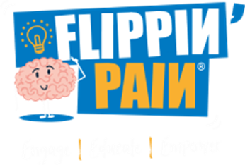
Resources
Sheffield:
Pain Management Programme
Sheffield Aches and Pains - Patients - rebranded patient self-help and clincian link
Getting Sheffield Active — Move More Sheffield ways to get more active
NHS Sheffield Talking Therapies Live well with pain course, access to mindfulness
Sheffield Flourish mental health charity and supportive community
Apps:
Social prescriber Joy - The right support is just a few clicks away
Back Pain: Chartered society of physiotherapy has a helpful video on back pain: Back Pain
Sleepio is available free on NHS for adults. https://onboarding.sleepio.com/sleepio/nhs/391#1/1 and for anxiety: https://www.bighealth.co.uk/daylight .
Videos: Tame the Beast video explaining chronic pain and Brainman on your tube
Find out if pain support group in your PCN. Consider ways of educating, signposting

Slide 13
Medicines Safety
MHRA and other national alerts
Folic Acid Supplementation - Continued advice for those who are planning a pregnancy or newly pregnant
Legislation has changed to mandate the fortification of non-wholemeal wheat flour with folic acid on a UK-wide basis to reduce the number of Neural Tube Defects (NTDs) in foetuses.
However, current UK guidelines still apply and women who could become pregnant are advised to take a daily supplement of 400 micrograms of folic acid before conception and up until the 12th week of pregnancy to reduce the risk of NTD-affected pregnancies.
Influenza season 2024/25: Use of antiviral medicines
Antiviral medicines may be prescribed for patients in clinical at-risk groups as well as anyone at risk of severe illness and/or complications from influenza if not treated, in line with NICE and UKHSA guidance.
UKHSA guidance advises testing to rule out COVID-19 as a minimum before prescribing.
Medroxyprogesterone acetate: Risk of meningioma and measures to minimise this risk
There is a small increased risk of developing meningioma with high doses of medroxyprogesterone acetate (all injectable and ≥100 mg oral formulations), primarily after prolonged use (several years).
Depot medroxyprogesterone acetate (DMPA) injections are widely used for contraception. The advice is changing:
Medicines containing high doses of medroxyprogesterone acetate are contraindicated in patients with a meningioma or a history of meningioma.
If meningioma is diagnosed in a patient treated with high doses of medroxyprogesterone acetate, treatment must be stopped.
Local DMPA PGDs will be updated to include this information.
Company led medicines recall: Leeds Trading Company LTC Ltd T/A LTC Healthcare, EXS Delay Spray Plus
LTC Healthcare has informed the MHRA that they have been selling a medicinal product containing lidocaine without authorisation from the MHRA. EXS Delay Spray Plus is being sold as a spray to delay ejaculation. There is limited information on the quantity of lidocaine present, therefore as a precautionary measure the product is being recalled on safety grounds.
Patients who experience adverse reactions or have any questions about the medication have been advised to seek medical attention. Any suspected adverse reactions or defects should also be reported via the MHRA Yellow Card scheme.

Slide 14
NICE GUIDANCE
Menopause: identification and management NG23 (Update)
NICE have reviewed the evidence and made new or updated recommendations on:
cognitive behavioural therapy to manage symptoms associated with the menopause.
managing genitourinary symptoms associated with the menopause.
the effects of hormone replacement therapy (HRT) on specific health outcomes:
HRT and the likelihood of some medical conditions: A discussion aid for healthcare professionals and patients
These recommendations are marked [2024].
NICE have produced useful resources/decision aids to support Person-Centred Care:
Combined HRT versus no HRT: effect on specific health outcomes
Oestrogen-only HRT versus no HRT: effect on specific health outcomes

Slide 15
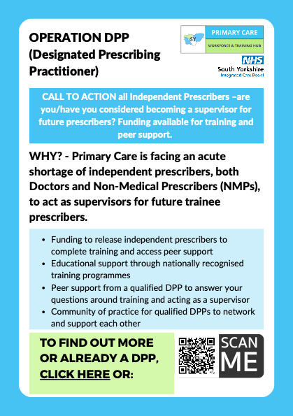
SY Workforce & Training Hub
Whether you feel ready to act as a supervisor or not, please take a moment to complete the following form
If you are an independent prescriber but are unsure if you are ready to support the future workforce and may need support to upskill, get in touch with Kel Tyers, kelly.tyers@nhs.net to find out more about the support on offer.

Slide 16
PrescQIPP updates
South Yorkshire ICB already subscribes to PrescQIPP, which means you can access a vast range of evidence-based, quality assured resources absolutely free.
Sign up to PrescQIPP today
Flyer for practice/PCN pharmacists and pharmacy technicians

Slide 17
Education and Training
NICE/BTS guideline on Asthma: diagnosis, monitoring and chronic asthma management
Tuesday 10th December 2024, 1pm-2pm
All registered subscribers can sign up here.
Social prescribing webinar 5
Social Prescribing for Major Conditions part 2
Tuesday 7th January 2025, 1pm-2pm
All registered subscribers can sign up here.

Slide 18
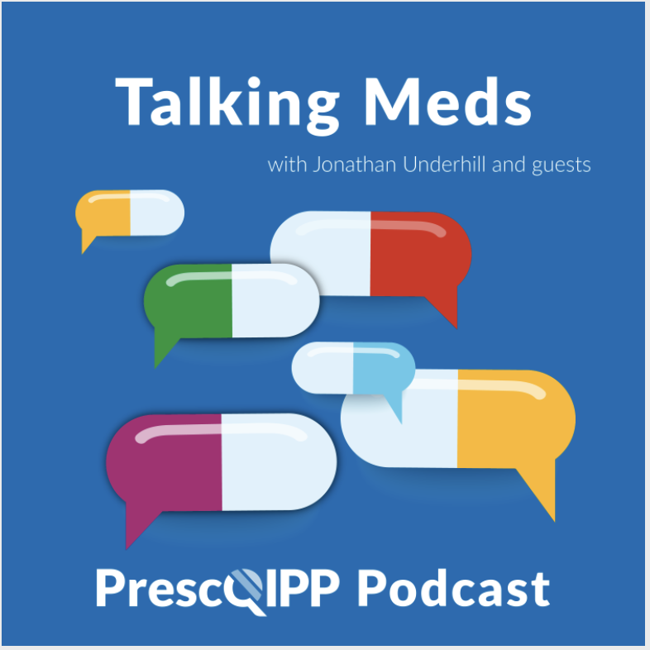
Education and Training
Talking Meds is available to listen to via your usual podcast system and a new episode will come out every fortnight, on the first and third Friday of each month.

Slide 19
Summy Key actions
Summary of key Actions
Add
Add any RED medicines prescribed by hospital as ‘hospital only medicines’ – not on repeat. Please share with colleagues to refer to SY ICB and Sheffield’s TLDL until the unification process is complete.
Check out
Check out learning opportunities (all of which are free to attend)
Familiarise
Familiarise yourself with medicines safety updates
Consider
Familiarise
Manage emotional impact. Safety netting is essential, Consider psychosocial
Familiarise yourself with the NICE Guidance update on Menopause and watch out for further guidance/formulary updates/educational resources to support prescribing in Sheffield.
support (NHS Talking Therapies). Use Ardens Opioid Agreement

Slide 20
Next APG– Learning Lunch
Thursday, 6th February 2025
click here to join the meeting
Feedback welcome.
Feedback forms can be found here

Slide 21
APG– Learning Lunch 2025 dates
No January 2025 meeting
Thursday 6th February click here to join the meeting
Thursday 6th March click here to join the meeting
Wednesday 16th April click here to join the meeting
Thursday 8th May click here to join the meeting
Thursday 5th June click here to join the meeting
Thursday 3rd July click here to join the meeting

Slide 22
If there are any issues you would like to raise or report to Sheffield Area Prescribing Group, please send these direct to the APG mailbox: syicbsheffield.areaprescribinggroupsheffield@nhs.net

Slide 24
Welcome - We will start at 12:30 Sheffield Area Prescribing Group – Learning Lunch 5 December 2024 Sheffield Medicines and Prescribing
Notes:
Good afternoon everyone and welcome to December’s APG Learning at lunch, which happens to be our last session for the year!

Slide 25
Introductions
Emily Parsons - Medicine Safety Officer
Barbara Obasi - Clinical Effectiveness Pharmacist
Helen Taylor – Lead Pharmacist
House Keeping
Notes:
Today, I am joined by my colleagues Emily the ICB’s medicines safety officer and Helen Taylor clinical lead pharmacist at the ICB

Slide 26
Missed the meeting/other learning lunch resources
https://www.intranet.sheffieldccg.nhs.uk/medicines-prescribing/learning-luncheseducational-events.htm
Notes:
Our feedback form is in the chat and we welcome your feedback to help shape future sessions.
the recording from today’s session as well as the slide set will be uploaded to the Sheffield medicines and prescribing page as shown on this slide.

Slide 27
Learning objectives
To be aware of latest updates & suggested actions:
IMOC Approved Traffic Light Drug List
Opioid Resources
Medicines Safety update
General prescribing update – NICE Guidance (Update)
Education &Training opportunities
Notes:
so for Today’s session will cover IMOC approved Traffic light drug list, Helen TAYLOR will be giving us an update on some new opioid resources approved at IMOC, Emily will present some relevant safety updates. We also have NICE guidance update, PrescQIPP updates and some free education and training opportunities.

Slide 28
Traffic Light Drug List
Drug | Indication | SY ICB Traffic Light Status
Dexcom One + Freestyle Libre 2+ |  | Amber G (1)
Canagliflozin Empagliflozin Dapagliflozin Ertugliflozin | Treating type 2 diabetes | Green
*** Please note: SY ICB GREY TLS is equivalent to BLACK on Sheffield’s TLDL***
To access both SY ICB TLDL and Sheffield place TLDL: Sheffield place intranet > Medicines and Prescribing > TLDL
Optimise Rx will be updated with all IMOC approved TLDL changes.
Avoid adding any RED medicines prescribed by hospital to patient’s repeat record. Add as ‘hospital only drug’
Notes:
a number of medicines were assigned a traffic light status at IMOC’s November meeting and this slide represents a snapshot. As an action, please continue to refer to the Sheffield traffic drug list as well as the IMOC list until the unification process is complete.

Slide 29
New SY Opioid Prescribing Resource
Opioid_Prescribing_Resource_Including_Tapering_Advice_v1.pdf helentaylor5@nhs.net
Notes:
I am now going to hand over to Helen Taylor to give us an update on Opioid resources.

Slide 30
Key headlines from Opioids Aware, Faculty of Pain Medicine
Opioids are very good analgesics for acute pain and for pain at the end of life, but there is little evidence that they are helpful for long-term pain.
A small proportion of people may obtain good pain relief with opioids in the long term if the dose can be kept low and especially if their use is intermittent.
Risk of harm increases substantially at doses above an oral morphine equivalent (OME) of 120 mg/day* but there is no increased benefit.
*Additional dosage increases beyond 50 mg/day OME are progressively more likely to yield diminishing returns in benefits for pain and function relative to risks to patients as dosage increases further.
If pain is severe despite opioid treatment, it means opioid isn't working and should be stopped, even if no other treatment is available.
Chronic pain is very complex and if patients have refractory and disabling symptoms, particularly if they are on high opioid doses, an assessment of the emotional influences on their pain experience is essential.

Slide 31
Indications for opioid tapering
Consider at least every 6-12 months irrespective of dose to assess benefit and side-effects.
Opioid no longer beneficial e.g. severe pain despite opioid. Consider using a pain scale e.g. British Pain Society Pain Scale
High dose opioid > 120 mg /day oral morphine equivalent (OME) where evidence shows risk of harm outweighs benefit (note: diminishing benefit and increased risks at doses above 50 mg /day OME – see here)
Condition for which opioid was prescribed has resolved e.g. joint replacement.
Person wants to stop taking the medicine e.g. intolerable adverse effects.
Problems associated with dependence have developed or strong evidence the person is diverting medication to others.
Having a 'conversation' is key!- discuss 'Tapering' at regular intervals (e.g. annual review) so patient can assess if still on-going benefit.
Try to ensure acute opioids don’t become long term. Increased risk of dependence and addiction if opioid taken for > 3 mths. Chronic pain is defined as pain last 3 mths or more.

Slide 32
Consider opioid side-effects
Not a complete list: …
Constipation
Weight gain
Hormonal effects - sexual dysfunction, amenorrhea, infertility
Depression / mood changes - people often don’t realise the negative impact opioids have on their mood and function
Reduced ability to fight infections
Memory loss
Increased risk of fractures (osteoporosis) and falls
Difficulty sleeping (snoring and breathing difficulties)
Opioid-induced hyperalgesia
Problems associated with dependence and addiction
Respiratory depression, increased mortality
Focus on those side-effects relevant to the patient. More likely to engage with the process

Slide 33
Agree and document a plan
Acknowledge and discuss with the person any differences between their views and your own about risks and benefits of taking an opioid.
If asked about previous prescribing decisions, explain our understanding of the balance of risks and benefits of opioid medicines has changed over time.
Aim: taper without withdrawal symptoms, example of Tapering Plans for each of the opioids.
Involve patient in decision about tapering plan
10% reduction every 1-2 weeks (consider every 4 weeks if opioid taken > 1 year or 'higher dose')
Fentanyl TD – if pt not coping with reduction consider small quantity of IR opioid (max 7 days after patch reduction).
Tolerance is soon lost so important to reiterate not to go back to a previous dose
Holistic techniques: Mindfulness, Relaxation, CBT, Psychological Support, Tai Chi, Exercise, Physiotherapy, Ice or Heat and Acupuncture, social prescriber, support group
If patient wanting to try alternative consider Mg OTC (375mg daily),
During a taper, some patients experience temporary increases in pain and withdrawal symptoms but reassure usually settles within 1 to 2 weeks. It can take up to 6 months after stopping opioids to feel back to normal. Encourage non-drug techniques (relaxation, distraction, music, walks etc.
Manage emotional impact. Safety netting is essential, Consider psychosocial support (NHS Talking Therapies). U Ardens Opioid Agreement (s/e listed on second page) and see PrescQIPP resources. Patient video, sample PIL)

Slide 34
Adding the SNOMED code as a problem will ensure it appears on the Summary Care Record; and will aid a clinician out of hours e.g. NHS111, Yorkshire Ambulance Service:
Opioid dosage tapering: 287041000000109
Opioid medication review: 287031000000100
Chronic pain: 82423001
Chronic pain review: 860381000000107
NICE Guidance
Do not initiate opioids:
Fibromylagia and chronic primary pain
Chronic low back pain
Chronic sciatica
Acute treatment of tension type headache, migraine and cluster headache
Do not offer strong opioid for OA (not routinely offer weak opioid)
If prescribing an opioid: avoid issuing full quantity for the month, So patient understands it's not to be taken every day (save for flare ups/ being able to do an activity then go back down) .
​Prescribe immediate release and not modified release. ​

Slide 35
Resources
Sheffield:
Pain Management Programme
Sheffield Aches and Pains - Patients - rebranded patient self-help and clincian link
Getting Sheffield Active — Move More Sheffield ways to get more active
NHS Sheffield Talking Therapies Live well with pain course, access to mindfulness
Sheffield Flourish mental health charity and supportive community
Apps:
Social prescriber Joy - The right support is just a few clicks away
Back Pain: Chartered society of physiotherapy has a helpful video on back pain: Back Pain
Sleepio is available free on NHS for adults. https://onboarding.sleepio.com/sleepio/nhs/391#1/1 and for anxiety: https://www.bighealth.co.uk/daylight .
Videos: Tame the Beast video explaining chronic pain and Brainman on your tube
Find out if pain support group in your PCN. Consider ways of educating, signposting
Notes:
Thanks Helen.

Slide 36
Medicines Safety
MHRA and other national alerts
Folic Acid Supplementation - Continued advice for those who are planning a pregnancy or newly pregnant
Legislation has changed to mandate the fortification of non-wholemeal wheat flour with folic acid on a UK-wide basis to reduce the number of Neural Tube Defects (NTDs) in foetuses.
However, current UK guidelines still apply and women who could become pregnant are advised to take a daily supplement of 400 micrograms of folic acid before conception and up until the 12th week of pregnancy to reduce the risk of NTD-affected pregnancies.
Influenza season 2024/25: Use of antiviral medicines
Antiviral medicines may be prescribed for patients in clinical at-risk groups as well as anyone at risk of severe illness and/or complications from influenza if not treated, in line with NICE and UKHSA guidance.
UKHSA guidance advises testing to rule out COVID-19 as a minimum before prescribing.
Medroxyprogesterone acetate: Risk of meningioma and measures to minimise this risk
There is a small increased risk of developing meningioma with high doses of medroxyprogesterone acetate (all injectable and ≥100 mg oral formulations), primarily after prolonged use (several years).
Depot medroxyprogesterone acetate (DMPA) injections are widely used for contraception. The advice is changing:
Medicines containing high doses of medroxyprogesterone acetate are contraindicated in patients with a meningioma or a history of meningioma.
If meningioma is diagnosed in a patient treated with high doses of medroxyprogesterone acetate, treatment must be stopped.
Local DMPA PGDs will be updated to include this information.
Company led medicines recall: Leeds Trading Company LTC Ltd T/A LTC Healthcare, EXS Delay Spray Plus
LTC Healthcare has informed the MHRA that they have been selling a medicinal product containing lidocaine without authorisation from the MHRA. EXS Delay Spray Plus is being sold as a spray to delay ejaculation. There is limited information on the quantity of lidocaine present, therefore as a precautionary measure the product is being recalled on safety grounds.
Patients who experience adverse reactions or have any questions about the medication have been advised to seek medical attention. Any suspected adverse reactions or defects should also be reported via the MHRA Yellow Card scheme.
Notes:
Over to you Emily

Slide 37
NICE GUIDANCE
Menopause: identification and management NG23 (Update)
NICE have reviewed the evidence and made new or updated recommendations on:
cognitive behavioural therapy to manage symptoms associated with the menopause.
managing genitourinary symptoms associated with the menopause.
the effects of hormone replacement therapy (HRT) on specific health outcomes:
HRT and the likelihood of some medical conditions: A discussion aid for healthcare professionals and patients
These recommendations are marked [2024].
NICE have produced useful resources/decision aids to support Person-Centred Care:
Combined HRT versus no HRT: effect on specific health outcomes
Oestrogen-only HRT versus no HRT: effect on specific health outcomes
Notes:
Thank you Emily
there has been an update to NG23 the NICE guidance on menopause.
Read slides out
PrescQIPP will be running a clinical master class on this NICE guidance ON THE 29TH of January 2025. Please check out their website for further information.

Slide 38
SY Workforce & Training Hub
Whether you feel ready to act as a supervisor or not, please take a moment to complete the following form
If you are an independent prescriber but are unsure if you are ready to support the future workforce and may need support to upskill, get in touch with Kel Tyers, kelly.tyers@nhs.net to find out more about the support on offer.
Notes:
SY workforce and training hub are running an Operation DPP
Read the why? As a result, the hub has secured some funding to release independent prescribers to complete training and access peer support. If you are an independent prescriber but are unsure if you are ready to support the future workforce and may need support to upskill, get in touch with Kel Tyers, kelly.tyers@nhs.net to find out more about the support on offer.

Slide 39
PrescQIPP updates
South Yorkshire ICB already subscribes to PrescQIPP, which means you can access a vast range of evidence-based, quality assured resources absolutely free.
Sign up to PrescQIPP today
Flyer for practice/PCN pharmacists and pharmacy technicians
Notes:
Just a quick update: PrescQIPP released several new bulletins in November. The insulin pen needles bulletin reviews the place in therapy of different pen needles and offers guidance for reviewing prescribing. . Our MOT clinical lead will evaluate this, and further details will be shared soon.”
The second bulletin, "Medicines Without Harm," offers resources to support local campaigns aligned with the WHO's global patient safety challenge, "Medication Without Harm." It covers five key areas: anticoagulants, insulins, NSAIDs, sodium valproate, and dependence-forming medicines (including opioids, benzodiazepines, Z-drugs, gabapentin, and pregabalin). Each campaign includes a bulletin, GP clinical system search, audit tools, patient letters, and public-facing materials.

Slide 40
Education and Training
NICE/BTS guideline on Asthma: diagnosis, monitoring and chronic asthma management
Tuesday 10th December 2024, 1pm-2pm
All registered subscribers can sign up here.
Social prescribing webinar 5
Social Prescribing for Major Conditions part 2
Tuesday 7th January 2025, 1pm-2pm
All registered subscribers can sign up here.
Notes:
Social prescribing
PrescQIPP have worked with the National Academy for Social Prescribing (NASP) to develop a series of webinars to raise awareness of social prescribing among pharmacists and pharmacy technicians, in various care settings. Attendees who complete all seven webinars (whether participating in the live events or having watched the recordings), will be awarded 'Social Prescribing Champion' status as part of the NASP clinical champion programme

Slide 41
Education and Training
Talking Meds is available to listen to via your usual podcast system and a new episode will come out every fortnight, on the first and third Friday of each month.
Notes:
Prescsqipp also run a podcast called talking meds with Jonathan underhill and guests. A new episode comes out every fortnight, on the first and third Friday of each month.

Slide 42
Summy Key actions
Summary of key Actions
Add
Add any RED medicines prescribed by hospital as ‘hospital only medicines’ – not on repeat. Please share with colleagues to refer to SY ICB and Sheffield’s TLDL until the unification process is complete.
Check out
Check out learning opportunities (all of which are free to attend)
Familiarise
Familiarise yourself with medicines safety updates
Consider
Familiarise
Manage emotional impact. Safety netting is essential, Consider psychosocial
Familiarise yourself with the NICE Guidance update on Menopause and watch out for further guidance/formulary updates/educational resources to support prescribing in Sheffield.
support (NHS Talking Therapies). Use Ardens Opioid Agreement

Slide 43
Next APG– Learning Lunch
Thursday, 6th February 2025
click here to join the meeting
Feedback welcome.
Feedback forms can be found here
Notes:
Our next meeting is

Slide 44
APG– Learning Lunch 2025 dates
No January 2025 meeting
Thursday 6th February click here to join the meeting
Thursday 6th March click here to join the meeting
Wednesday 16th April click here to join the meeting
Thursday 8th May click here to join the meeting
Thursday 5th June click here to join the meeting
Thursday 3rd July click here to join the meeting

Slide 45
If there are any issues you would like to raise or report to Sheffield Area Prescribing Group, please send these direct to the APG mailbox: syicbsheffield.areaprescribinggroupsheffield@nhs.net

