Slide 1
Welcome - We will start at 12:30 Sheffield Area Prescribing Group – Learning Lunch 6 March 2025 Sheffield Medicines and Prescribing

Slide 2
Introductions
xx
Shameila Afsar-Baig- Senior Pharmacist (Strategy and Delivery Sheffield Place)
Emily Parsons- Medicine Safety Officer (SY ICB)
Hilde Storkes- Lead Pharmacist (Formulary Sheffield Place)
Helen Taylor- Lead Pharmacist (Sheffield Place)
Kirsty Burdett- Senior Pharmacist Endocrine CE (SY ICB)
House Keeping

Slide 3
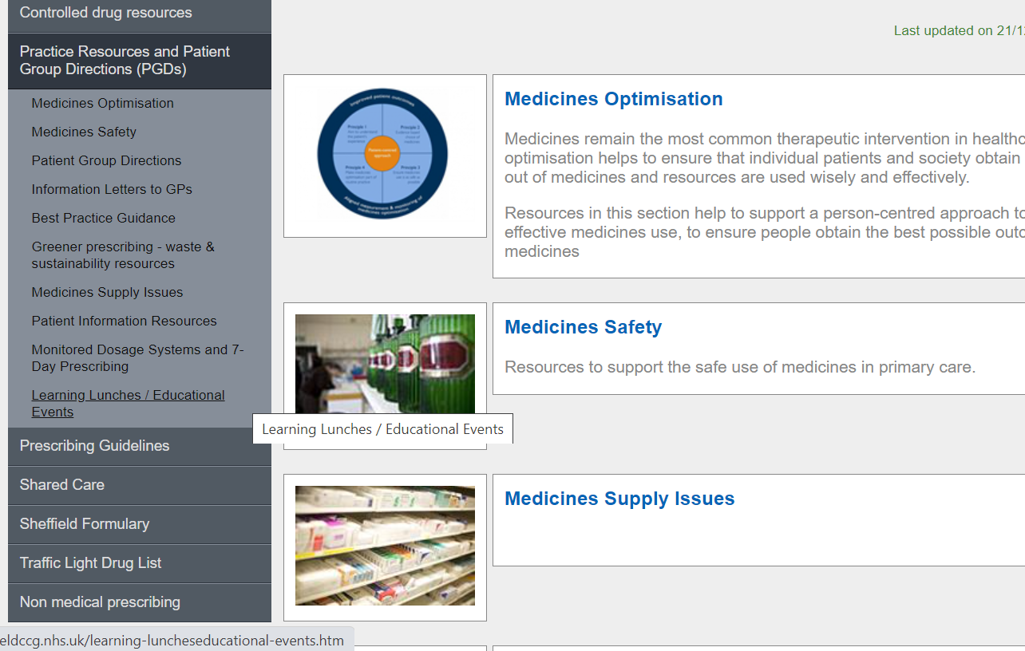
Missed the meeting/other learning lunch resources
https://www.intranet.sheffieldccg.nhs.uk/medicines-prescribing/learning-luncheseducational-events.htm

Slide 4
Learning objectives
To be aware of latest updates & suggested actions:
IMOC Approved Traffic Light Drug List
Migraine Management in Primary Care (update)
Prescribing Guidance for Ibandronic Acid 50mg tablets as adjuvant therapy in early breast cancer (update)
Formulary change- Gliptins
Wicker Medicines Substitution Service
Endometrial protection guidelines
Medicines Safety update
Education &Training opportunities

Slide 5
Traffic Light Drug List
Drug | Indication | SY ICB Traffic Light Status
Tirzepatide for managing overweight and obesity | NICE TA1026-managing overweight and obesity | GREY (6)
Alimemazine | All licensed indications- urticaria and pruritus( already traffic lighted Amber if initiated for sleep disorders in children by tertiary sleep service in SCH (unlicensed indication) | GREY (4)
Spironolactone (new oral solution formulations) | Congestive cardiac failure, hepatic cirrhosis with ascites and oedema, malignant ascites, nephrotic syndrome and diagnosis and treatment of primary aldosteronism | GREEN
*** Please note: SY ICB GREY TLS is equivalent to BLACK on Sheffield’s TLDL***
To access both SY ICB TLDL and Sheffield place TLDL: Sheffield place intranet > Medicines and Prescribing > TLDL
Optimise Rx will be updated with all IMOC approved TLDL changes.
Avoid adding any RED medicines prescribed by hospital to patient’s repeat record. Add as ‘hospital only drug’

Slide 6
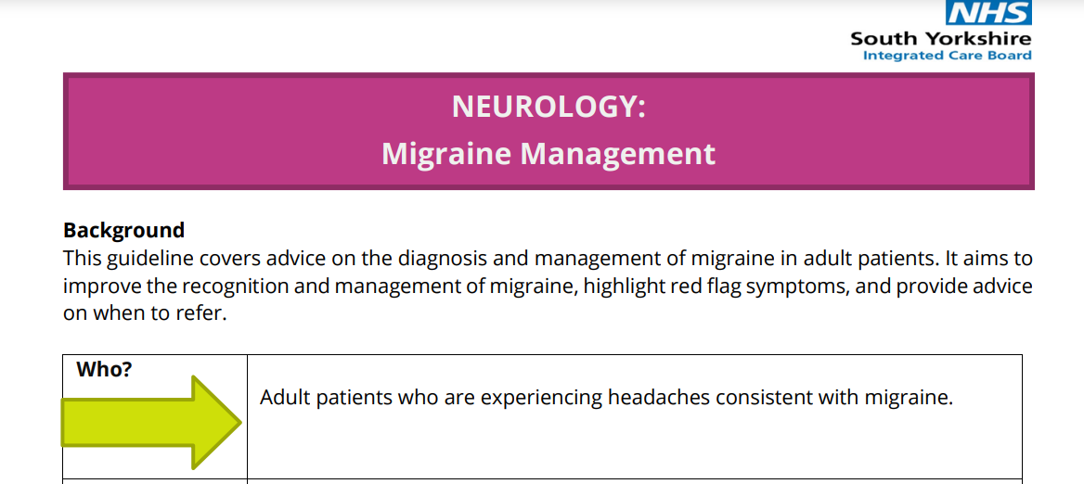
Neurology: Migraine Management update
Author: Dr Fiona McKevitt, Consultant Neurologist at STH / Neurology CASES team
Update to Neurology: Migraine Management (Press Portal) - New version adopted across SY and on IMOC website.
Headache presentation by Dr McKevitt Feb 25, included migraine and these documents: Access via: Non-Medical Prescribing (NMP)
New:
Pharmacological Treatment Pathway of Migraine – shows different medicines available for migraine across Primary and Secondary Care
Topiramate Pregnancy Prevention Programme information and links. Topiramate is contraindicated for migraine prophylaxis in pregnancy. It is also contraindicated in women of childbearing potential unless the conditions of the Pregnancy Prevention Programme (PPP) are fulfilled.

Slide 7
Migraine Management Changes for Primary Care
Acute treatment now includes rimegepant 75mg oral lyophilisate:
In line with NICE TA 919 for acute treatment– Green on SY TLDL (note dual indication)
Patients unable to take a triptan or at least 2 triptans tried and were ineffective / not tolerated, and simple analgesia is not effective.
Rimegepant is a new drug class in Primary Care, therefore developed supporting information:
Preventive treatments for episodic migraine (> 4 but < 15 migraines per month):
No change to available medication in primary care, but all preventives now listed (not prioritising beta blocker or topiramate ahead of others e.g. amitriptyline)
Rimegepant 75mg alternate days currently Red on SY TLDL.
Clinicians: Rimegepant Supporting Information For Acute Treatment of Migraine (Includes rimegepant prescribing information; and section on triptans. Triptans will continue to be the main treatment and important they’re taken correctly)​
Patient Information Leaflet: Rimegepant for Treating a Migraine Attack​
Clinicians can get specialist advice via: sth.headacheservice@nhs.net.
New SY Neurology Migraine Management (includes red flags, referral criteria, patient resources e.g. headache diary, BASH PILs, HIT-6, Migraine Trust link) + Rimegepant PIl and Supporting info
Please use these new documents and if any questions email helentaylor5@nhs.net

Slide 8
Update to Prescribing Guidance: Ibandronic acid 50mg tablets as adjuvant therapy in early breast cancer - link here. Key changes:
No change to patient group but now clearly defined: AMBER SY TLDL. Off-label use for post-menopausal women with breast cancer and pre-menopausal women receiving ovarian suppression or are to have an oophorectomy at sufficient increased risk of recurrence will be offered a bisphosphonate (by the hospital specialist). Link added to STH PIL
No change to duration of treatment but made clearer: Patients who have had chemotherapy will usually get 6 months IV Zoledronate at the hospital so only need further 2.5 years by GP. Total 3 years with bisphosphonate (either IV zoledronate or oral ibandronate)
No change to Annual Blood Tests and Annual Review in Primary Care: calcium and U&Es (now use CrCl and not eGFR as per manufacturers recommendation. Dose reduction required if CrCl < 50 mL/min).
New Adverse Effects table: MHRA alerts and action to take if hypocalcaemia develops.
New Advice for Reviewing Bone Health On Stopping Ibandronate: Identify eligible groups for Fracture Risk Assessment and DEXA 12 months post stopping ibandronate. Those with osteoporosis previously on bisphosphonate therapy stopped due to starting ibandronic acid and those on an aromatase inhibitor and/or ovarian suppression that increases the risk of cancer therapy induced bone loss.
If not tolerated / stopped please inform specialist
Optimise Rx alert to remind clinicians to add 'STOP date' as Ibandronic acid may not be reviewed by hospital specialist. Please be mindful when chemotherapy given patient may not require full 3 year treatment with ibandronic acid. Use the guidance for annual blood test and review.

Slide 9
Medicines Substitution Service @ Wicker Pharmacy
New service to substitute a prescribed out of stock medicine with a suitable alternative
by Wicker Pharmacy’s Independent Prescribing (IP) Pharmacists, Brendan Walker and Rebecca Hammond
This provision falls under the NHSE IP Pathfinder Programme
Ideally to alleviate some of the pressures for GPs and patients when medicines are difficult to get hold of
More Info 24/02/25 GP bulletin and here

Slide 10
Formulary Change: Gliptins
Dipeptidyl peptidase-4 inhibitors, DPP-4 inhibitors, (also known as “gliptins”) are a class of oral diabetic medications used in the management of type 2 diabetes mellitus (T2DM) in adults. There are currently 5 gliptins licensed in the UK: alogliptin, linagliptin, sitagliptin, saxagliptin, and vildagliptin.
In line with NICE guidelines (NG28), gliptins are indicated in patients with T2DM (and who are not at high cardiovascular disease risk) as monotherapy (if metformin is inappropriate), or in combination with other antidiabetic drugs (including insulin) if existing treatment fails to control HbA1c to below the person’s individually agreed threshold.
Gliptins should also not be prescribed in conjunction with Glucagon-Like Peptide-1 receptor agonists (GLP-1 RAs) as they both work on the same pathway increasing risk of associated acute pancreatitis.
Meta-analyses of gliptins (used as monotherapy) show they all provide similar, modest reduction in HbA1c. NICE guidance recommends when reviewing patients on current diabetic treatment that: ‘medicines that have had no impact on glycaemic control or weight, unless there is an additional clinical benefit, such as cardiovascular or renal protection’, should be discontinued.
Unlike some other agents used in the treatment of T2DM, there is no evidence to suggest that gliptins confer any significant cardiovascular benefits however they do show cardiovascular safety. DPP-4 inhibitors are weight neutral and do not induce hypoglycaemia.

Slide 11
Formulary Change: Gliptins
DPP-4 Inhibitors | Formulary Status across South Yorkshire | Usual dose
Sitagliptin (generic) | First line/preferred cost-effective gliptin Generic sitagliptin is first line for all eligible patients/new initiations. Where existing patients are prescribed a different gliptin, and ongoing prescribing of a gliptin is indicated following diabetes review, switch to generic sitagliptin if appropriate. HbA1c should be checked as usual in line with NICE guidance i.e. every 3 – 6 months. | 100mg OD 50mg OD - eGFR ≥ 30 to < 45mL/min/1.73m²: 25mg OD - eGFR < 30 mL/min/1.73m²:
Linagliptin | Second line Linagliptin is the second line gliptin to be used only after sitagliptin has been tried, or if eGFR 45ml/min/1.73m² | 5mg OD (No dose adjustment required in renal impairment)
Alogliptin (NB: Not licensed in monotherapy) | Not recommended for new patients Where existing patients are prescribed alogliptin, and ongoing prescribing of a gliptin is indicated following next diabetes review, switch to generic sitagliptin if appropriate | 25mg OD
Saxagliptin | Not recommended for new patients Advice as per Alogliptin | 5mg OD 2.5mg once daily eGFR < 45 mL/min/1.73 m²
Vildagliptin | Not recommended for new patients Advice as per Alogliptin | 50mg BD 50mg once daily eGFR < 50 mL/min/1.73 m²:
Gliptin Combination Products | Not recommended for new patients Advice as per Alogliptin | As per individual SPC’s

Slide 12
Progestogens for endometrial protection when using HRT Guidance for Sheffield Primary Care www.intranet.sheffieldccg.nhs.uk/Downloads/Medicines%20Management/prescribing%20guidelines/Progestogens.pdf
Aim: to support the use of progestogens in individuals with a uterus receiving HRT; to optimise the dose and choice of progestogen in proportion to the oestrogen dose and to manage unscheduled bleeding.
Is complementary to the SYB Cancer Alliance: Guidance for patients on HRT with unscheduled bleeding
https://syics.co.uk/application/files/3417/2372/6971/Guidance_for_patients_on_HRT_with_unscheduled_bleeding_Vs_3.0_SY_Cancer__Alliance.pdf
Based on BMS guidelines and local recommendations, including Sheffield Formulary progestogen choices.
Familiarise with recommendations in the guideline and appendices

Slide 13
Progestogens for endometrial protection when using HRT (cont'd)
Oestrogen alone HRT will increase the risk of endometrial hyperplasia over 1-3 years.
Women with an intact uterus need either sequential (cyclical) progestogen for 12-14 days per cycle, if less than 12 months since last LMP, or continuous (combined) if more than 12 months since LMP. Appendix 1 lists standard dose progestogens and Sheffield Formulary choices.
The dose of progestogen should be in proportion to the oestrogen dose. See Appendix 2 in guideline (taken from BMS 2024 joint guidance).
Unscheduled bleeding – consider increasing the progestogen dose or using an alternative type.
Use of Mirena (or equivalent 52mcg LNG-IUD) reduces episodes of unscheduled bleeding when compared with other progestogen preparations.
Advice is given on the off-label use of oral micronised progesterone by the vaginal route. This may reduce progestogenic side-effects if other progestogens are not suitable. No evidence pv reduces unscheduled bleeding over oral route, but may be trialled if alternatives are not suitable.

Slide 14
Medicines Safety
MHRA and other national alerts
Valproate (Belvo, Convulex, Depakote, Dyzantil, Epilim, Epilim Chrono or Chronosphere, Episenta, Epival, and Syonell ▼): review by two specialists is required for initiating valproate but not for male patients already taking valproate
Review by two specialists remains in place for patients initiating valproate under 55 years of age but the Commission on Human Medicines (CHM) has advised that it will not be required for men (or males) currently taking valproate.
Three infographics have been produced to clarify in which situations review by two specialists may be required:
for female patients under 55 years old
for male patients under 55 years old
for male and female patients 55 years and older
Voluntary Notification Defective Medicine – Medikinet® XL10mg capsules and Medikinet® XL 20mg capsules (methylphenidate hydrochloride)
A small number of defects in the colouring of Medikinet XL 10mg & 20mg capsules has been identified. As a result of light exposure, the ‘mauve’ colour of the capsules may appear ‘blue’. The defect does not have any effect to the medicinal product’s efficacy and tolerability.
Notification of Seroxat® (paroxetine hydrochloride) 10mg, 20mg and 30mg tablets discontinuation
GSK has notified the MHRA and DHSC that Seroxat® 20mg tablets will be discontinued in the UK from March 2025, Seroxat® 30mg from May 2025 and Seroxat® 10mg from November 2025 for commercial reasons.
Generic versions of paroxetine hydrochloride 10mg, 20mg and 30mg tablets are available.
Class 2 Medicines Recall: Boots Paracetamol 500 mg tablets (16s), EL(25)A/10
Aspar Pharmaceuticals Limited have informed the MHRA of an error related to a batch of Boots Paracetamol 500 mg tablets (16s). The foil blister inside the carton incorrectly states ‘Aspirin 300 mg Dispersible Tablets’. The tablets are confirmed to be Paracetamol 500 mg tablets.

Slide 15
Medicines Safety (continued)
Legislative Changes
The Medicines (Gonadotrophin-Releasing Hormone Analogues) (Restrictions on Private Sales and Supplies) Order 2024
This Order came into force on 1st January 2025 and extends and applies to England and Wales, Scotland and Northern Ireland.
Since 3 June 2024, temporary emergency restrictions have been in place preventing the use of gonadotrophin releasing hormone (GnRH) analogues used to suppress puberty as part of treatment for gender incongruence or gender dysphoria in children and young people under 18 years of age.
On 11 December 2024 the Government passed further legislation to maintain the restrictions permanently, following a targeted consultation and advice on patient safety from the CHM and the Cass Review.
Primary care prescribers are only able to provide NHS prescriptions for GnRH analogues in the following circumstances:
the patient is aged 18 years or over
or
the patient is 17 years or under, and the purpose of the prescription is for a medical condition other than gender incongruence, gender dysphoria or gender affirmation
or
the patient is 17 years or under and has been issued with a prescription for a GnRH analogues for puberty suppression in the 6-month period prior to 26 June 2024; then they may continue to be issued with prescriptions for GnRH analogues for that purpose on and after that date.
The NHS prescription must be endorsed ‘SLS’ by the prescriber.
The Human Medicines (Amendments Relating to Naloxone and Transfers of Functions) Regulations 2024
Following a consultation by the Department of Health and Social Care (DHSC), the Human Medicines Regulations (2012) (HMR) have been changed to widen access to naloxone. These changes came into force on 2nd December 2024.
Existing exemptions in the HMRs allow drug treatment services to supply naloxone for future use (‘take home’ naloxone) to those who need it, without a prescription. This exemption has been expanded to include:
medical services of the armed forces
police forces, including drug treatment workers commissioned to work in these settings.
prison staff
probation officers
registered midwives
registered nurses
registered pharmacy professionals
registered paramedics
These new powers are enabling, and not mandatory. The intention of these changes is to provide an opportunity for provision, based on local need.

Slide 16
Education and Training
NICE guidance and the safe use of valproate and topiramate Professor Helen Cross and Professor Arjune Sen to talk about NICE guidance and safe use of valproate and topiramate. Tuesday 25th March 2025, 1pm-2pm
All registered subscribers can sign up here
South Yorkshire ICB already subscribes to PrescQIPP, which means you can access a vast range of evidence-based, quality assured resources absolutely free.
Sign up to PrescQIPP today
Flyer for practice/PCN pharmacists and pharmacy technicians

Slide 17
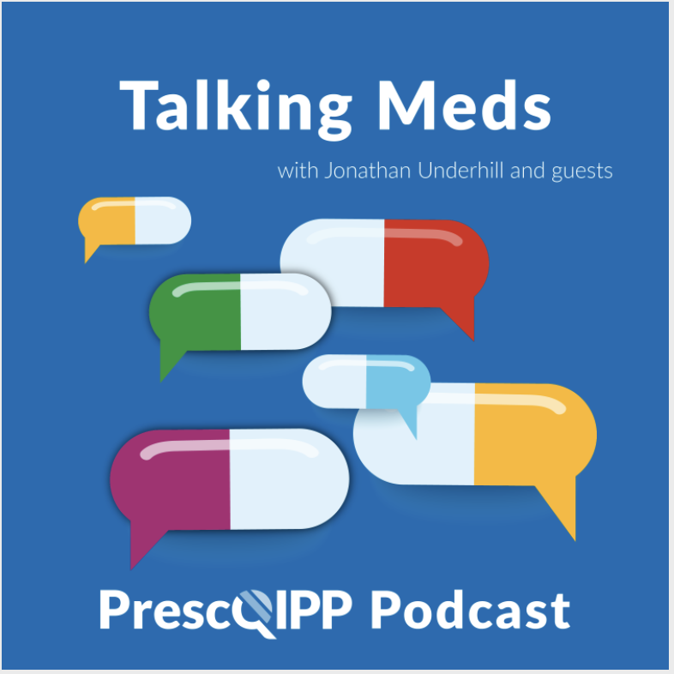
Education and Training
Talking Meds is available to listen to via your usual podcast system and a new episode will come out every fortnight, on the first and third Friday of each month.
Engaging conversations about medicines hosted by Jonathan Underhill who chats with a guest at each episode about current medical issues and clinical dilemmas.

Slide 18
Summy Key actions
Summary of key Actions
Add
Add any RED medicines prescribed by hospital as ‘hospital only medicines’ – not on repeat. Please share with colleagues to refer to SY ICB and Sheffield’s TLDL until the unification process is complete.
Familiarise
Check out
Check out
New rimegepant documents for treating acute migraines. Including info for clinicians and a PIL.
The 24/02/25 GP bulletin or link here for the new medicines’ substitution service @ wicker pharmacy
Check out
The updated Neurology: Migraine management guideline, now SY wide on IMOC webpage
Be mindful of
Ibandronic acid update: total duration of treatment with bisphosphonates is 3yrs. Optimise Rx will alert to add STOP date.
Familiarise
Check out
learning opportunities (all of which are free to attend)
Yourself with medicines safety updates
Familiarise
Yourself with the formulary update: Gliptins
Yourself with recommendations in the Progestogens for endometrial protection when using HRT guideline and appendices

Slide 19
Next APG– Learning Lunch
Wednesday 9th April 2025
click here to join the meeting
Feedback welcome.
Feedback forms can be found here

Slide 20
APG– Learning Lunch 2025 dates
Wednesday 9th April click here to join the meeting
Thursday 8th May click here to join the meeting
Thursday 5th June click here to join the meeting
Thursday 3rd July click here to join the meeting

Slide 21
If there are any issues you would like to raise or report to Sheffield Area Prescribing Group, please send these direct to the APG mailbox: syicbsheffield.areaprescribinggroupsheffield@nhs.net

