Slide 1
Welcome - We will start at 12:30 Sheffield Area Prescribing Group – Learning Lunch 7 November 2024 Sheffield Medicines and Prescribing

Slide 2
Introductions
Sharron Kebell - Specialised Commissioning Pharmacist
Emily Parsons - Medicine Safety Officer
Kieran Wootton – SY ICB Trainee Pharmacist
Barbara Obasi - Clinical Effectiveness Pharmacist
House Keeping

Slide 3
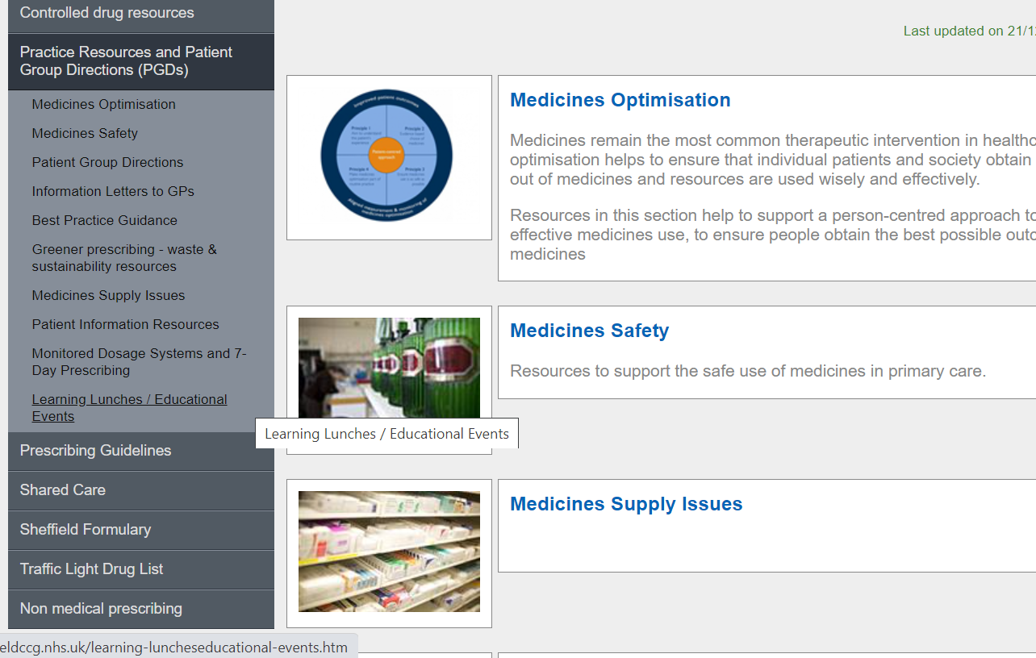
Missed the meeting/other learning lunch resources
https://www.intranet.sheffieldccg.nhs.uk/medicines-prescribing/learning-luncheseducational-events.htm

Slide 4
Learning objectives
To be aware of latest updates & suggested actions:
IMOC Approved Traffic Light Drug List
SNOMED coding for Hydroxychloroquine (HCQ) Retinal Monitoring - a Reminder
Sulfasalazine Prescribing
Medicines Supply Issues - GLP-1 agonists; PERT
Medicines Safety update
General prescribing update
Education &Training opportunities
Notes:
In today’s session, we will be covering ….

Slide 5
Traffic Light Drug List
Drug | Indication | SY ICB Traffic Light Status
Deferiprone Darunavir (including in combination) | Iron overload in patients with thalassaemia major HIV infection | Red (1)
Gefapixant citrate |  | Grey (7)
Varenicline Bupropion Nicotine replacement Products Vibegron Empagliflozin | Nicotine dependence Treating symptoms of overactive bladder syndrome Treating type 2 diabetes in people 10 to 17 years | Green
*** Please note: SY ICB GREY TLS is equivalent to BLACK on Sheffield’s TLDL***
To access both SY ICB TLDL and Sheffield place TLDL: Sheffield place intranet > Medicines and Prescribing > TLDL
Optimise Rx will be updated with all IMOC approved TLDL changes.
Avoid adding any RED medicines prescribed by hospital to patient’s repeat record. Add as ‘hospital only drug’
Notes:
A number of medicines were assigned a traffic light status at October’s imoc meeting. Just as a reminder, please continue to refer to the Sheffield traffic light list as well as imoc traffic light list, until the unification process is complete.
Optimise Rx will be updated accordingly.
I am now going to pass us on to sharron who will be giving us further updates

Slide 6
A Reminder - to add SNOMED code for Hydroxychloroquine (HCQ) Retinal Monitoring to the Clinical Record
On receipt of retinal monitoring result from ophthalmology, please add SNOMED code 1104901000000103 for hydroxychloroquine retinopathy monitoring to patient record. For future audit this will you to ascertain whether retinal monitoring has been done / is up to date:
Where a patient has been prescribed HCQ for longer than 5 years, or those patients who have been identified as high-risk patients who need annual retinal monitoring, please consider adding a prescription note to HCQ prescriptions, advising to check at annual review that annual retinal monitoring has been done and that SNOMED code added in previous 12 months.
Consider adding a reminder to the front screen, documenting when HCQ started and that needs retinal monitoring when patient been on treatment for 5+ years.
Please note: HCQ retinal monitoring does not constitute diabetic eye screening and so GP practices are advised to be mindful of the correct codes in diabetic patients also on HCQ.

Slide 7
Sulfasalazine Prescribing
Salazopyrin EN® has recently been re-branded by Pfizer as a generic (Sulfasalazine 500 mg gastro resistant (GR) tablets) and there are now no stocks of Salazopyrin EN® available in the community.
The following are available for prescribing / dispensing (prices from November’s Drug Tariff):
Sulfasalazine 500 mg gastro resistant (GR / EC) tablets- (generic) - £70.17 for 112
Sulfasalazine 500 mg plain tablets – (generic) - £5.78 for 112
Most of the prescribing in primary care is for rheumatological indications but only the GR / enteric coated (EC) versions are licensed for this indication. Furthermore, experience from local specialists indicate that the GR / EC version is better tolerated by patients.
We advise that patients prescribed Salazopyrin EN® are switched to sulfasalazine GR tablets.
You may wish to consider switching patients from Salazopyrin EN® to sulfasalazine 500 mg GR tablets on an individual basis or via bulk switching.

Slide 8
Medicines Supply Problem - Insulins
Diabetic Specialist Nurses are going to send guidance out to / liaise with the affected GP practices by end on the year (2024)
For those GP practices who are prescribing above - expect contact from DSNs with advice by end on the year (2024)

Slide 9
Medicines Safety
National Patient Safety Alerts
Shortage of Kay-Cee-L® (potassium chloride 375mg/5ml) (potassium chloride 5mmol/5ml) syrup
This NatPSA supersedes NatPSA/2024/008/DHSC (July 2024)
Kay-Cee-L® syrup will be discontinued from late November 2024 due to manufacturing and commercial issues.
The updated NatPSA contains the following new required action:
Part-dosing of Sando-K® effervescent tablets is not routinely recommended but can be done if unlicensed specials are not available.
In exceptional circumstances, when unlicensed specials are not available, clinical teams should ensure that patients and/or carers are trained on how to administer the correct dose and can demonstrate safe administration of part-doses. Each patient should also receive a completed copy of the Medicines for Children leaflet 'How to give calcium, phosphate or potassium using effervescent tablets'.
The NPPG have produced an updated position statement and guidance on unlicensed oral potassium liquid products.
MHRA and other national alerts
GLP-1 receptor agonists: reminder of the potential side effects and to be aware of the potential for misuse
It is important that patients are aware of the potential ADRs associated with these GLP-1RAs when used for weight loss.
Patients should also be warned of the risk of falsified GLP-1RA medicines for weight loss if not prescribed by a registered healthcare professional.
All suspected ADRs, even those known to occur, should be reported to the Yellow Card Scheme. Ensure as much detail as possible is recorded, including details if suspicion of inappropriate use or misuse and where the product was obtained (i.e. NHS prescription, private prescription, including online prescriptions, or illegitimate supplier).

Slide 10
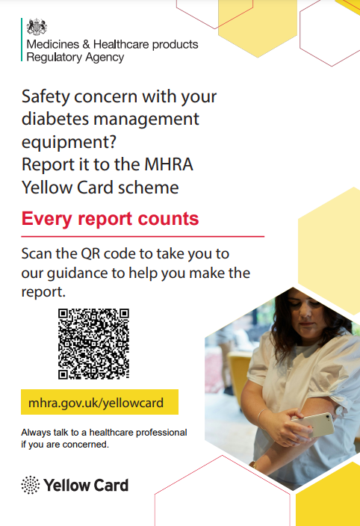
Medicines Safety
MHRA and other national alerts (continued)
Insulin pumps and continuous glucose monitoring (CGM) equipment: guidance for users on reporting suspected adverse incidents and safety concerns to the MHRA’s Yellow Card scheme
Insulin pumps and CGM devices are complex devices with the potential to result in serious harm in the event of error.
The MHRA have produced new guidance, aimed specifically at device users and their families, care givers and representatives, on why reporting concerns is important, what information they should include, and step-by-step instructions on how to create a Yellow Card report.
The MHRA requests that HCPs bring the guidance to the attention of patients using insulin pumps and CGM devices. A poster is available with a direct link to the guidance (QR code) which can be printed to display in clinic waiting rooms.
Bromocriptine: monitor blood pressure when prescribing bromocriptine for prevention or inhibition of post-partum physiological lactation
A safety review has highlighted that blood pressure monitoring of patients prescribed with this drug is essential especially during the first days of treatment. It should only be prescribed for the prevention or suppression of postpartum lactation where medically indicated, in cases such as intrapartum loss, neonatal death, or a mother with HIV infection.
If patients prescribed bromocriptine present with signs and symptoms of hypertension, treatment should be discontinued, and the patient evaluated promptly by a HCP.
Class 2 Medicines Recall: Tillomed Laboratories Limited, Labetalol 200mg Tablets, EL(24)A/52
A limited number of labetalol 200mg tablets (Batch Number 240537) cartons may contain a blister strip of Vera-Til SR 240mg Tablets, (verapamil), PL 11311/0078 (Batch Number 240750) with the blister strips of labetalol 200mg tablets.
Pharmacists should identify and immediately contact all patients who have, or could have, been dispensed the impacted batch and, where appropriate, consider contacting the patient’s GP. Any patients who may have taken verapamil instead of labetalol, should be contacted by their prescriber directly to ensure that their treatment is reviewed, and a suitable alternative product is prescribed.

Slide 11
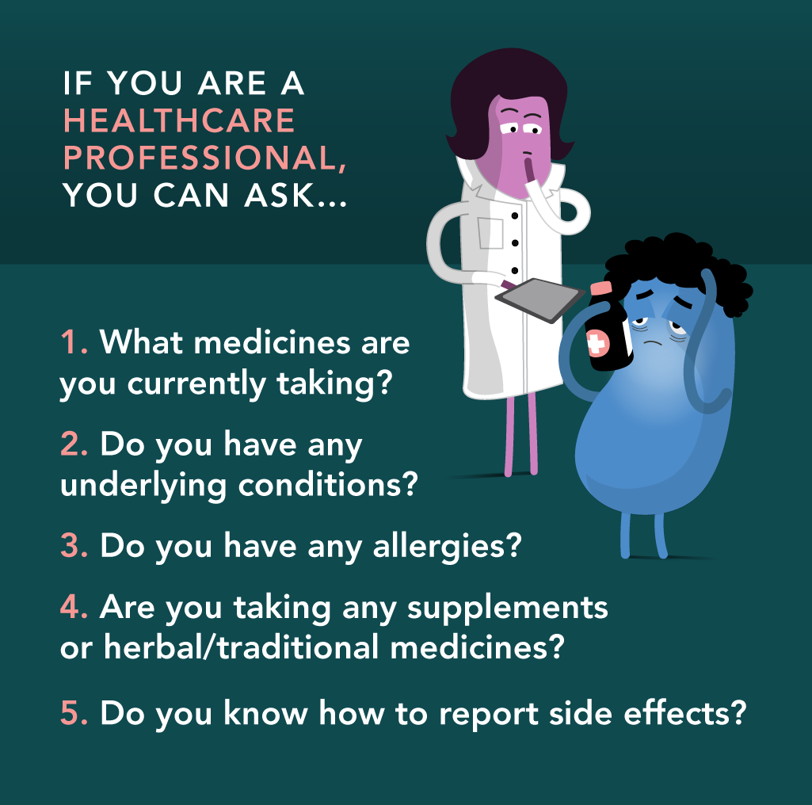
Annual #MedSafetyWeek 2024 (4th-10th November)
#MedSafetyWeek is a global social media campaign to encourage the reporting of suspected side effects.
The theme for 2024 is ‘preventing side effects’
The focus is on the importance of reporting suspected ADRs to medicines and vaccines as well as suspected problems with medical devices or other healthcare products to the Yellow Card scheme.
What healthcare professionals can do to support #MedSafetyWeek:
Follow MHRA social media channels during the week – retweet, comment, like and share safety messages using #MHRAYellowCard, #MedSafetyWeek, #PatientSafety and #ReportSideEffects
Report suspected ADRs to medicines to the MHRA Yellow Card Scheme or via the Yellow Card app (download from the Apple App Store or Google Play Store)
Also report ADRs where harm occurs due to adverse incidents with medical devices (including software, apps and artificial intelligence), safety concerns about e-cigarettes and their refill containers (e-liquids), adverse reactions to herbal or homeopathic medicines and defective, low-quality or falsified (fake) healthcare products
Have conversations patients about:
the importance of taking the right medicine, at the right time, in the right way and at the right dose and of carefully following instructions for use of medical devices
the importance of reading the PILs
what to do if they experience problems with a healthcare product, such as contacting a healthcare professional and self-reporting to the Yellow Card scheme.
Accredited e-learning modules are available for doctors, pharmacists and nurses which count for CPD credits. See https://yellowcard.mhra.gov.uk/resources/elearning
For more detailed information, see the MHRA Drug Safety Update, the Yellow Card website and the Uppsala Monitoring Centre’s website
94 countries
107 organisations

Slide 12
PrescQIPP updates
New STOMP data tool
A new tool to help identify numbers and proportion of patients with dementia (without psychosis) prescribed an antipsychotic and number of patients with a learning disability prescribed a medicine in the STOMP guidance.
South Yorkshire ICB already subscribes to PrescQIPP, which means you can access a vast range of evidence-based, quality assured resources absolutely free.
Sign up to PrescQIPP today
Flyer for practice/PCN pharmacists and pharmacy technicians

Slide 13
Education and Training
Prescribing Mastery webinar:
Session 1: Unlocking excellence: Mastering Severe Mental Illness for our patients
Wednesday 20 November 2024, 1pm-2pm
All registered subscribers can sign up here.
Practice Plus
Managing Heart Failure in Primary Care - Heart Failure Reviews
Thursday 28 November 1pm-2pm
All registered subscribers can sign up here.

Slide 14
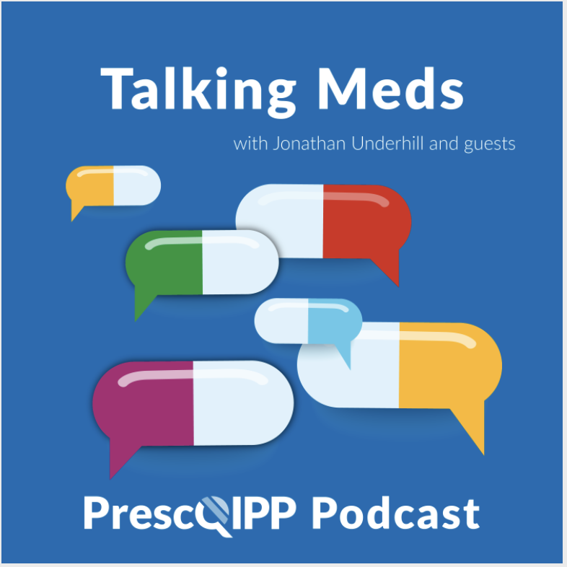
Education and Training
Talking Meds will be available to listen to via your usual podcast system and a new episode will come out every fortnight, on the first and third Friday of each month.

Slide 15
Summy Key actions
Summary of key Actions
Add
Add any RED medicines prescribed by hospital as ‘hospital only medicines’ – not on repeat. Please share with colleagues to refer to SY ICB and Sheffield’s TLDL until the unification process is complete.
Check out
Check out learning opportunities (all of which are free to attend)
Register
Familiarise yourself with medicines safety updates
Share
Expect
Familiarise
Suggested actions to aid addition of hydroxychloroquine retinal monitoring SNOMED codes to clinical record with relevant members of GP practice team
Register with SPS to review live Medicines Supply Tool
Ensure
patients on Salazopyrin EN® are considered for switching to sulfasalazine GR
Medicines Supply Problem – Insulins: Expect contact from DSNs with advice by end on the year (2024)

Slide 16
Next APG– Learning Lunch
Thursday, 5th December 2024
Click here to join the meeting
Feedback welcome.
Feedback forms can be found here

Slide 17
APG– Learning Lunch 2025 dates
No January 2025 meeting
Thursday 6th February click here to join the meeting
Thursday 6th March click here to join the meeting
Wednesday 16th April click here to join the meeting
Thursday 8th May click here to join the meeting
Thursday 5th June click here to join the meeting
Thursday 3rd July click here to join the meeting

Slide 18
If there are any issues you would like to raise or report to Sheffield Area Prescribing Group, please send these direct to the APG mailbox: syicbsheffield.areaprescribinggroupsheffield@nhs.net

