Slide 1
Welcome - We will start at 12:30 Area Prescribing Group – Learning Lunch Wednesday 9 October 2024 Sheffield Medicines and Prescribing

Slide 2
Introductions
Sharron Kebell- Specialised Commissioning Pharmacist
Diana Vasile – Clinical Pharmacist
Emily Parsons – Medicine Safety Officer
House Keeping
Feedback welcome – see form in chat

Slide 3
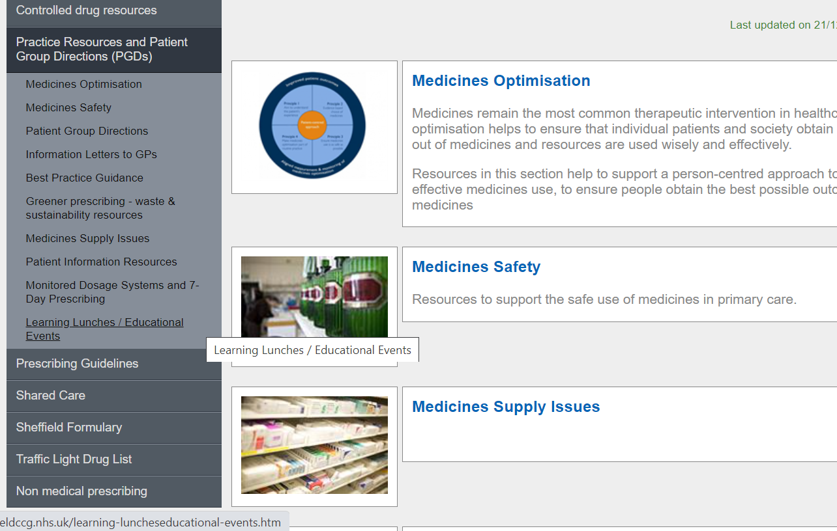
Missed the meeting/other learning lunch resources
https://www.intranet.sheffieldccg.nhs.uk/medicines-prescribing/learning-luncheseducational-events.htm

Slide 4
Learning objectives
To be aware of latest updates & suggested actions:
Traffic Light Drug List
Cardiovascular Formulary Update
Chronic Kidney Disease Guideline Update
Sulfasalazine / Salazopyrin & supply Issues
Medicines Safety update
Education &Training opportunities

Slide 5
Traffic Light Drug List
Drug | Indication | SY ICB Traffic Light Status
Rimegepant | Remains Red for preventing episodic migraine (≥ 4 migraines but < 15 per month). In line with positive NICE TA recommendation for Acute treatment of migraines. | Green for acute episodes of migraine (primary care can initiate / prescribe) Supporting information being developed and planning education session with headache specialists (hopefully Nov/Dec) New class of drug treatment in primary care; therefore may prefer to wait until the above has been finalised before prescribing this new treatment option
*** Please note: SY ICB GREY TLS is equivalent to BLACK on Sheffield’s TLDL***
To access both SY ICB TLDL and Sheffield place TLDL: Sheffield place intranet > Medicines and Prescribing > TLDL
Optimise Rx will be updated with all IMOC approved TLDL changes.
Avoid adding any RED medicines prescribed by hospital to patient’s repeat record. Add as ‘hospital only drug - see SIDs
Notes:
It’s green for acute if clinician wishes to prescribe; but secondary care are aware that we are still waiting for approval of supporting information and PIL.

Slide 6
Formulary Updates
Cardiovascular (Chapter 2) formulary chapter update –
A number of changes have been made in line with previous APG/IMOC agreements:
Metolazone is amber G in line with IMOC TLDL
Finerenone for CKD in T2DM added as amber with link to SY ICB SCP
Dapagliflozin and empagliflozin for heart failure:
added links to NICE TA902,TA929 for HFpEF/HFmrEF respectively; amber on the TLDL
link updated to primary care guidance for dapagliflozin and empagliflozin for HFrEF; amber on the TLDL
Dapagliflozin and empagliflozin for CKD: Sheffield CKD primary care guidance now includes both SGLTi (green on TLDL); under review for addition of finerenone.
Note: to avoid confusion, all dapagliflozin and empagliflozin TLD classifications are listed on the Sheffield TLDL.

Slide 7
Cardiovascular (Chapter 2) formulary chapter update (cont’d)
Oral anticoagulants
Removal of edoxaban as first choice DOAC for SPAF, removal of links to Sheffield position statement on DOAC procurement and edoxaban quick reference prescribing guide.
No preference stated on choice of DOAC for SPAF: note to refer to NHS operational note for DOAC procurement and Sheffield SPAF guideline (see next slide)
Lipid modification
addition of link to updated NICE guidance NG238 Cardiovascular disease: risk assessment and reduction, including lipid modification
Note added that Sheffield primary and secondary prevention of CKD guidelines are under review.
note updates and follow formulary recommendations

Slide 8
Sheffield SPAF guidance: amendment Sept 2024
Rivaroxaban generic has dropped in price on Drug Tariff, and NHSE has updated their operational note on DOAC procurement.
Our SPAF guidelines are now in line with this:
Generic apixaban and generic rivaroxaban are joint best value:
generic apixaban * - first-line twice daily option
generic rivaroxaban - first-line once daily option
*note price concession in Aug and Sept
Links have been added to generic rivaroxaban PIL and SmPC
Start new patients in line with latest advice; further guidance on switches may be issued in due course

Slide 9
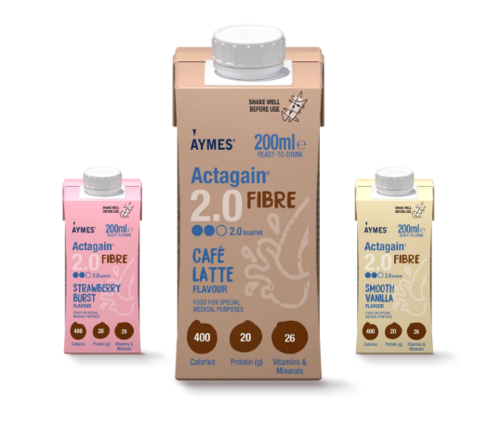
The Aymes range is changing product names
AYMES Actagain 2.0 previously AYMES 2kcal now includes additional protein per serving (still 400Kcal). Presentation & flavour changes too
new product to this range too - AYMES Actagain 2.0 Fibre
3 flavours – Café latte, strawberry burst and smooth vanilla
400kcal
20g protein
5g fibre
All flavours of Actagain 2.0 Fibre are suitable for vegetarians (except strawberry burst). As for many Aymes products
 | Previous | NEW
Name | AYMES 2.0kcal | AYMES Actagain 2.0
Volume | 200ml bottle | 200ml Tetra Pak
Protein | 16g protein | 20g protein
Flavours | Vanilla Strawberry Banana | Vanilla Creme​ Berry Medley​ Café Latte​ Dulce de Leche ​ Golden Apricot​ Neutral

Slide 10
Salazopyrin EN ® / Sulfasalazine Supply Issue
Salazopyrin EN® has recently been re-branded by Pfizer and there is now limited /no stocks available in the community
the following are still available - (prices from Drug Tariff):
Sulfasalazine 500 mg GR tablets- (generic) - £70.17 for 112
Sulfasalazine 500 mg plain tablets – (generic) - £5.89 for 112
Sulfasalazine 500mg GR tablets are licensed for IBD and rheumatoid arthritis
Sulfasalazine 500mg plain tablets are just licensed for IBD
N.B.Sulfasalazine is not generally started by gastro-enterologists, it just tends to be used when patients also have concomitant rheumatoid conditions.
Sulfasalazine Shared Care Protocol Patients with rheumatoid arthritis, and those treated over a long period with NSAIDs, may have sensitive stomachs and for this reason enteric-coated sulfasalazine (Salazopyrin® EN-Tabs) are recommended for this disease,
Local (STH) rheumatology specialists only support use of GR / EC in their patients
Consider switching patients currently prescribed Salazopyrin EN ® to sulfasalazine GR /EC
Notes:
From a SystmOne search in Sheffield, 14% of the RA patients currently prescribed sulfasalazine on repeat are prescribed plain tablets (unlicensed)

Slide 11
Supply Issue
See SPS Medicines Supply Tool for further information (registration required)
ADHD medications national shortage
MSN 2024/086 methylphenidate prolonged-release tablets
Heads up:
MSN/2024/088 norethisterone (Noriday®) 350mcg tabs
MSN/2024/092 and update isosorbide mononitrate 60mg MR tabs and caps (inc. Sheffield Formulary choice Chemydur® 60mgXL – supply expected 11 Oct)
MSN/2024/082 ramipril 2.5mg tabs (caps available - Sheffield MM formulary choice)
MSN/2024/095 trandolapril 2mg and 4mg caps (non-formulary ACEi)
MSN/2024/096 nicorandil 10mg tabs (supply expected 4 Oct)
MSN/2024/101 Trandate® 50mg tabs (labetalol) - to be discontinued July 2025

Slide 12
Medicines Safety
Local updates
Medicines with teratogenic potential
Updated to include the new valproate and topiramate regulations.
MHRA and other national alerts
Urgent Field Safety Notice - Lacri-Lube
A packaging /sterility breach has resulted in potentially microbially contaminated product. Using contaminated eye ointment can lead to potential infections that can range from minor to life threatening.
Clinicians to be alert to the potential for adverse reactions in patients using Lacrilube.
Class 2 Medicines Recall: Pfizer Limited, Oxbryta 500mg Tablets (voxelotor)
FIO - Hospital only drug, classed as Red on the SY IMOC TLDL. No prescribing in primary care in Sheffield
Pfizer Limited is recalling all distributed batches of Oxbryta 500 mg Tablets. Pfizer Limited has informed the MHRA that the product is being withdrawn due to emerging data from clinical trials and registry-based studies.
Physicians, specialist prescribers, homecare company providers or any other healthcare professional responsible for prescribing Oxbryta will contact all patients undergoing treatment and advise them to discontinue treatment and, where appropriate, discuss alternative treatment options. Patients will be instructed to return the product to the hospital pharmacy or homecare company that dispensed it.

Slide 13
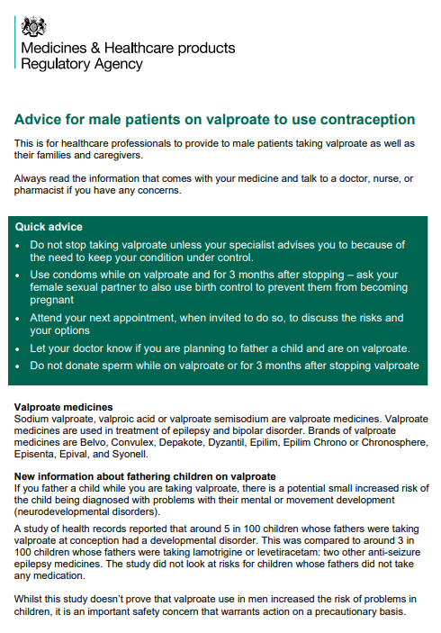
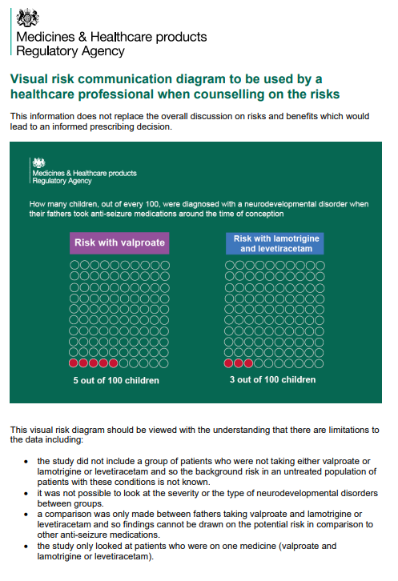
Medicines Safety
Valproate use in men: as a precaution, men and their partners should use effective contraception
A retrospective observational study has indicated a possible association between valproate use by men around the time of conception and an increased risk of neurodevelopmental disorders in their children. Inform male patients who may father children of this possible increased risk and the recommendation to use effective contraception during valproate treatment and for at least 3 months after stopping valproate.
In February 2024, Sheffield clinical systems data showed 554 male patients under 55 years of age with a repeat prescription of a valproate medication. 348 of these patients are on the epilepsy register; 146 are on the mental health register; 33 have SNOMED codes for migraine.
Male patients will need information and advice about the new guidance.
SmPCs for most valproate products have been updated and now state:
'As a precautionary measure, GPs and specialists should inform male patients about this potential risk and recommend the need for male patients and their female partner to use effective contraception, while using valproate and for at least 3 months after treatment discontinuation.' and
'Male patients treated with valproate should be regularly reviewed by their GP or specialist. For male patients planning to conceive a child, the specialist should consider and discuss other suitable treatment options with the male patients. Individual circumstances should be evaluated in each case.'
The MHRA have produced a visual risk communication diagram and PIL to support discussions. Product PILs and hard-copies of the updated safety and educational materials will be available in the coming months.

Slide 14
Chronic Kidney Disease (CKD): prescribing update
Sheffield Chronic Kidney Disease Management in Adults Guideline for Primary Care : empagliflozin, second SGLT2i licensed for the treatment of CKD added, in line with TA942.
SY SCP for The use of Finerenone in patients with CKD (this has been added to the CKD guideline and awaiting ratification) in line with NICE TA877 :
Finerenone is recommended as an option for treating CKD 3 and 4 with albuminuria ( (uACR) > 3 mg/mmol ) associated with type 2 diabetes in adults, only if:
it is an add-on to optimised standard care; this should include, unless they are unsuitable, the highest tolerated licensed doses of:
• ACEi or ARBs and
• SGLT2i and
the person has an eGFR of 25 ml/min/1.73 m² or more.
Initiaton: secondary care with starting dose based on eGFR: 10mg daily for eGFR 25-60ml/min/1.73m2. Can be increased to 20mg daily in line with potassium levels.
Maintenance dose (once optimised by secondary care): in line with potassium levels
Monitoring: as for chronic kidney disease status of the patient, with regular monitoring of potassium levels and eGFR to determine the treatment dose. For more information, contraindications & cautions see SCP
Key messages:
Empagliflozin: Green for CKD on SY TLDL
Document CKD as indication
Finerenone: Amber for CKD on SY TLDL
It is the responsibility of secondary care to initiate and optimise finerenone therapy before requesting GP to take over prescribing
Annual reviews in secondary care, however once stable with no anticipated changes, ongoing reviews can be managed solely in primary care.
Discontinue if the eGFR falls below 15ml/min
Familiarise yourself with the CKD guideline updates and the finerenone SCP

Slide 15
PrescQIPP updates
Bulletin 352 launched - Insomnia
This bulletin contains recommendations to optimise prescribing in insomnia.
Bulletin 353 launched – Dependence forming medicines
This bulletin provides support for prescribing of and managing withdrawal from dependence forming medicines including; opioids, benzodiazepines, gabapentinoids, Z-drugs and antidepressants in primary care.
Bulletin 354 launched – Lancets
This bulletin advises on cost effective choices of lancets and highlights the NHS England commissioning recommendations. It also advises on the appropriate use of safety lancets.
South Yorkshire ICB already subscribes to PrescQIPP, which means you can access a vast range of evidence-based, quality assured resources absolutely free. Sign up to PrescQIPP today
Flyer for practice/PCN pharmacists and pharmacy technicians

Slide 16
Education and Training
Upcoming Practice Plus webinar –
Demystifying Research in Primary Care
Wed 16th October, 1pm - 2pm
Social prescribing webinars
__
To view recordings and register for remaining sessions click here

Slide 17
Education and Training
Prescribing Mastery webinars
–
click here to find out more

Slide 18
SPS - Education and Training
MSATS
Safe use of DOACs
30TH October
12:30-14:00
Register here

Slide 19
Summy Key actions
Summary of key Actions
Add
Add any RED medicines prescribed by hospital as ‘hospital only medicines’ – not on repeat. Please share with colleagues to refer to SY ICB and Sheffield’s TLDL until the unification process is complete.
Note & follow
Check out
Check out learning opportunities (all of which are free to attend)
Register
Familiarise yourself with CKD guideline updates and the finerenone SCP
Start
Consider
Familiarise
new patients on DOACs in line with latest advice; further guidance on switches may be issued in due course
Register with SPS to review live Medicines Supply Tool
Updates to the cardiovascular (chapter 2) formulary section
switching patients currently prescribed Salazopyrin EN ® to sulfasalazine GR /EC

Slide 20
Next APG– Learning Lunch
Thursday, 7th November 2024
Click here to join the meeting
Feedback welcome.
Feedback forms can be found here

Slide 21
APG– Learning Lunch - dates for 2024
Thursday 7th November Click here to join the meeting
Thursday 5th December Click here to join the meeting

Slide 22
Questions?
If there are any issues you would like to raise or report to Sheffield Area Prescribing Group, please send these direct to the APG mailbox: syicbsheffield.areaprescribinggroupsheffield@nhs.net

